Slide 1
AVIAN HAZARD ADVISORY SYSTEM (AHAS)
Web Page Update
Florida : California : Hawaii : Calgary : London : Beijing
www.detect-inc.com www.dronewatcher.com
Copyright 2022, DeTect, Inc, All Rights Reserved

Slide 2
OBJECTIVE
Introduce users to the use of the new web page.
1
Copyright 2022, DeTect, Inc, All Rights Reserved

Slide 3
OVERVIEW
What is AHAS?
Calculating NEXRAD risk
New web page
Chart
2
Copyright 2022, DeTect, Inc, All Rights Reserved

Slide 4
AHAS
Tracks bird movements within low level flight arena for the contiguous 48 states and Alaska
Found at https://www.usahas.com
Uses Level 2 NEXRAD data, National Weather Service (NWS) Forecasts, Soaring Bird Forecast Models, and the Bird Avoidance Model (BAM) to track bird movements
Provides CONUS and Alaska bird strike risk for:
IR, VR, and SR routes
Ranges and MOA’s
Some Military and Civilian Airfields
Alert Areas
3
Copyright 2022, DeTect, Inc, All Rights Reserved

Slide 5
CALCULATING NEXRAD RISK
RASTER LAYERS
REGIONAL MOSAICS
FLYING AREAS
EXTRACTION
OPERATIONAL RISK MANAGEMENT (ORM)
4
Copyright 2022, DeTect, Inc, All Rights Reserved

Slide 6
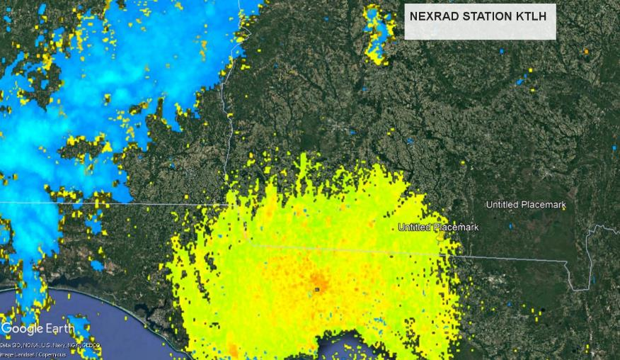
RASTER IMAGES
AHAS downloads data from the NOAA Amazon web services (AWS) and converts the raw data into a 640x427 raster images. Then the weather suppression software removes the weather from the image. AHAS does this for 169 NEXRAD stations. This image shows station KTLH in Google Earth.
5
Copyright 2022, DeTect, Inc, All Rights Reserved

Slide 7
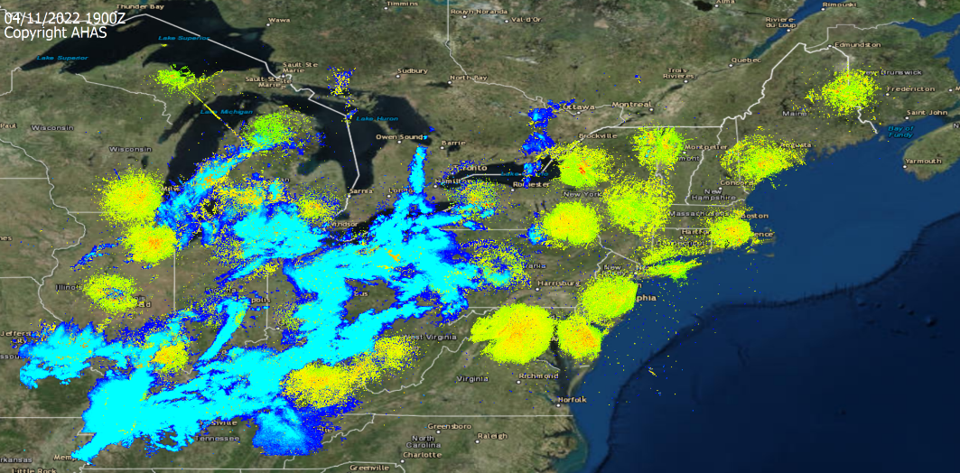
REGIONAL MOSAICS
Every six minutes AHAS concatenates the individual radar raster images into regional raster layers. This images shows the NE region in Google Earth.
6
Copyright 2022, DeTect, Inc, All Rights Reserved

Slide 8
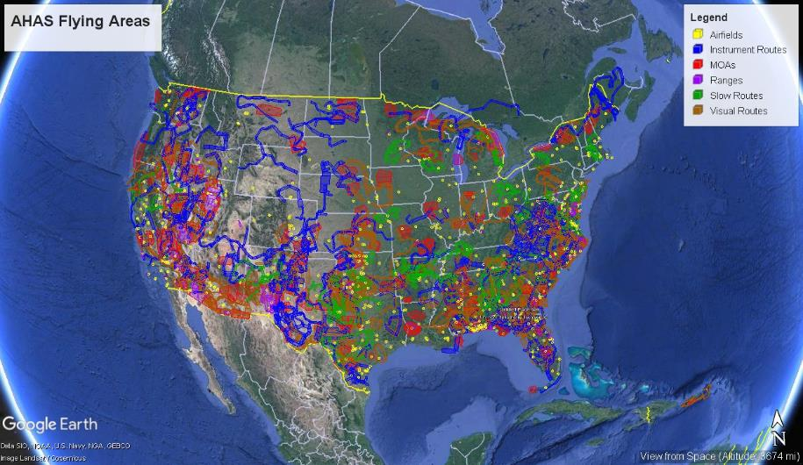
FLYING AREAS
The flying layers are also in raster layers. This image shows all the flying areas in Google Earth.
7
Copyright 2022, DeTect, Inc, All Rights Reserved

Slide 9
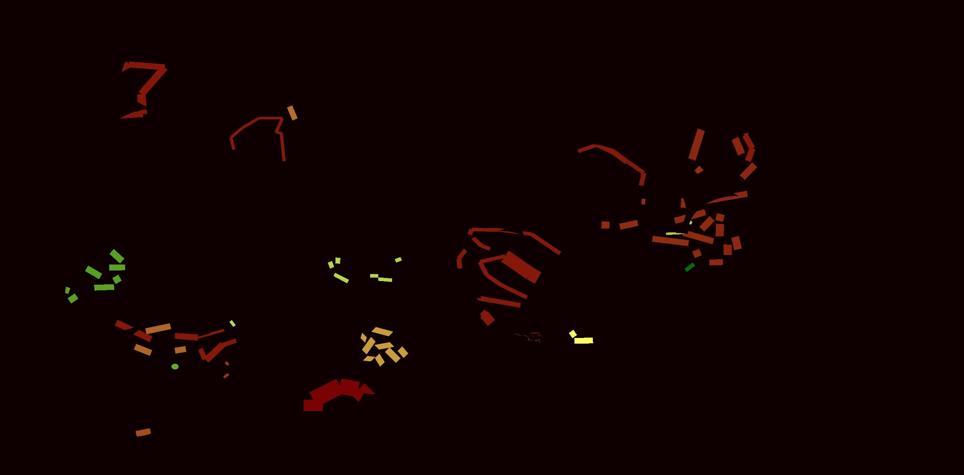
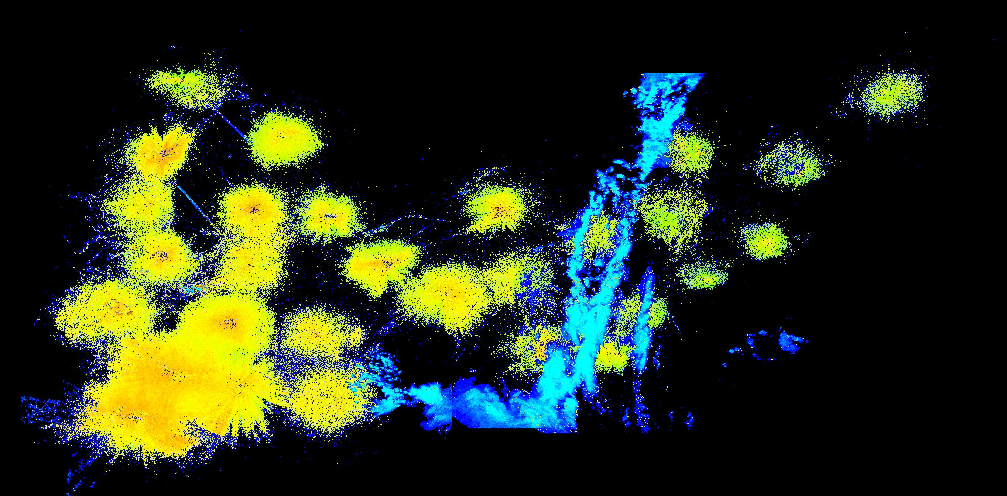
EXTRACTION
After the mosaics are created, the percentage of the polygon that has biological activity and the average dBZ value of the NEXRAD return are extracted for each flying area.
8
Copyright 2022, DeTect, Inc, All Rights Reserved

Slide 10
Operation Risk Management ORM
The risk is determined by the Operation Risk Management chart (ORM).
Probability is a function of the percentage of pixels with biological radar returns within any risk polygon (MOA, Route Segment, Airfield).
Severity of outcome is a function of the average reflectivity(dBZ) values within the risk polygon.
The higher the reflectivity values, the greater the biomass in that area of airspace.
<= 300 = Low, > 4000 = Severe
 | Probability
Severity (z) | 20 | 40 | 60 | 80 | 100
3 | 60 | 120 | 180 | 240 | 300
10 | 200 | 400 | 600 | 800 | 1000
30 | 600 | 1200 | 1800 | 2400 | 3000
100 | 2000 | 4000 | 6000 | 8000 | 10000
300 | 6000 | 12000 | 18000 | 24000 | 30000
9
Copyright 2022, DeTect, Inc, All Rights Reserved

Slide 11
ARCHIVE
SQL data is archived.
All flying areas listed in AHAS.
NEXRAD sample areas.
NEXRAD risk.
SOAR risk.
Over 20 years of data for some areas.
10
Copyright 2022, DeTect, Inc, All Rights Reserved

Slide 12
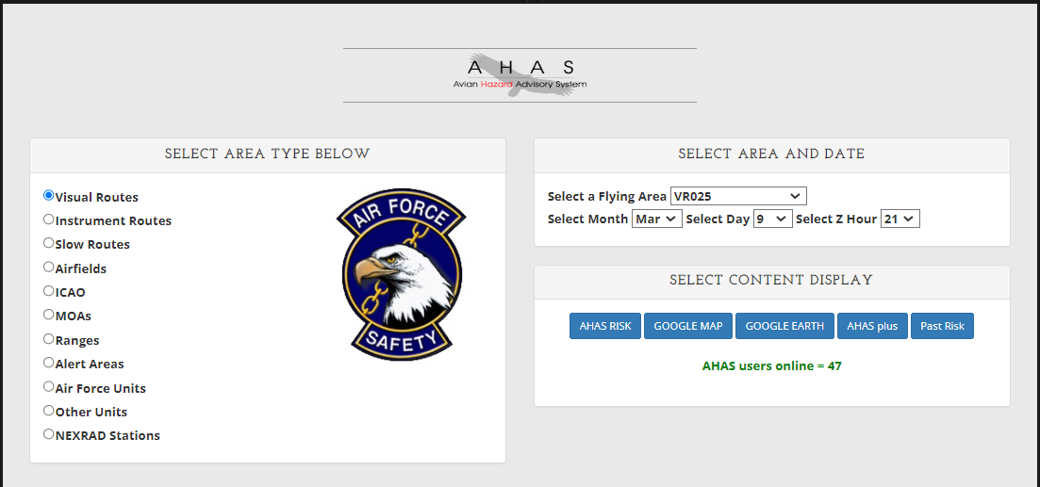
New Web Page - options
Added NEXRAD stations as an option.
Replaced 12Hour risk with Past Risk button.
No longer a check box to load the chart. Chart will automatically load if available.
10
Copyright 2022, DeTect, Inc, All Rights Reserved

Slide 13
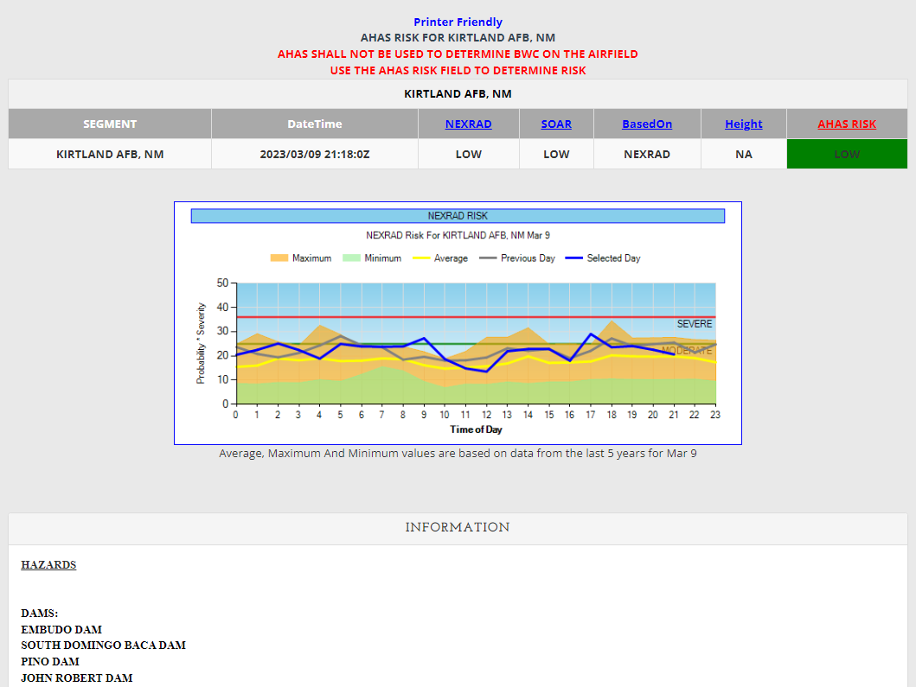
New Web Page -results
Column headers are clickable for more information.
The old BAM risk has been replaced by a BAM based on five years of NEXRAD data.
If the selected month is the current month, the chart will show the selected day(blue) and previous day(gray).
10
Copyright 2022, DeTect, Inc, All Rights Reserved

Slide 14
Chart
Most recent 5 years of data.
Updated every month.
Almost 4 billion rows of data.
Chart shows hourly values for the selected day.
The risk values showed in the charts are based on the Log10 of the NEXRAD risk value.
Max value
Min value
Average value
Values for the selected day and previous day. Only available for the current month.
Min and max year the data is based on.
10
Copyright 2022, DeTect, Inc, All Rights Reserved

Slide 15
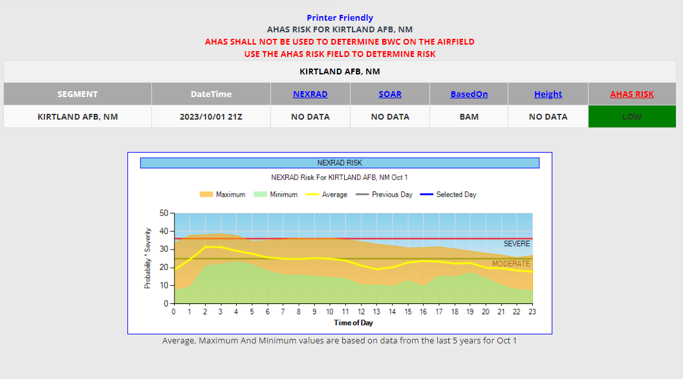
Chart - routes
You can select any month/day and get the chart. The table will only display BAM data if not within the current time period.
BAM data is based on five years of NEXRAD data.
Selecting any of the routes(VR, SR, IR) or will create a chart that shows the min(green area), max(orange area) and average(yellow line) values for all segments of the route.
11
Copyright 2022, DeTect, Inc, All Rights Reserved

Slide 16
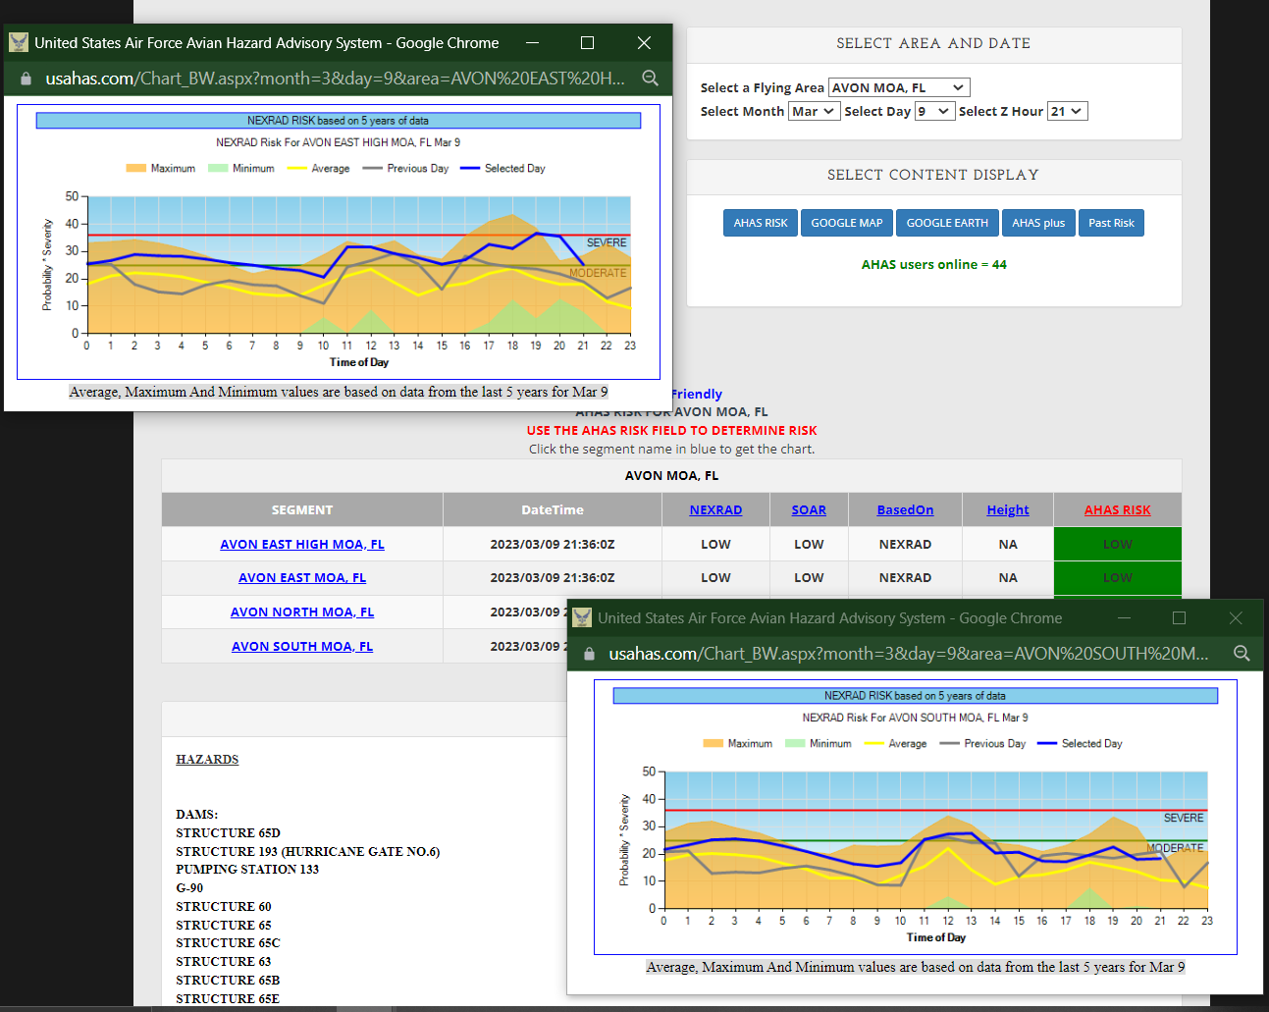
Chart – MOA, ranges, alert areas
If selecting a MOA, range or alert area the chart will not display on the current web page.
Click the “segment” highlighted in blue to see a chart for that “segment”.
You can have multiple charts open at the same time.
11
Copyright 2022, DeTect, Inc, All Rights Reserved

Slide 17
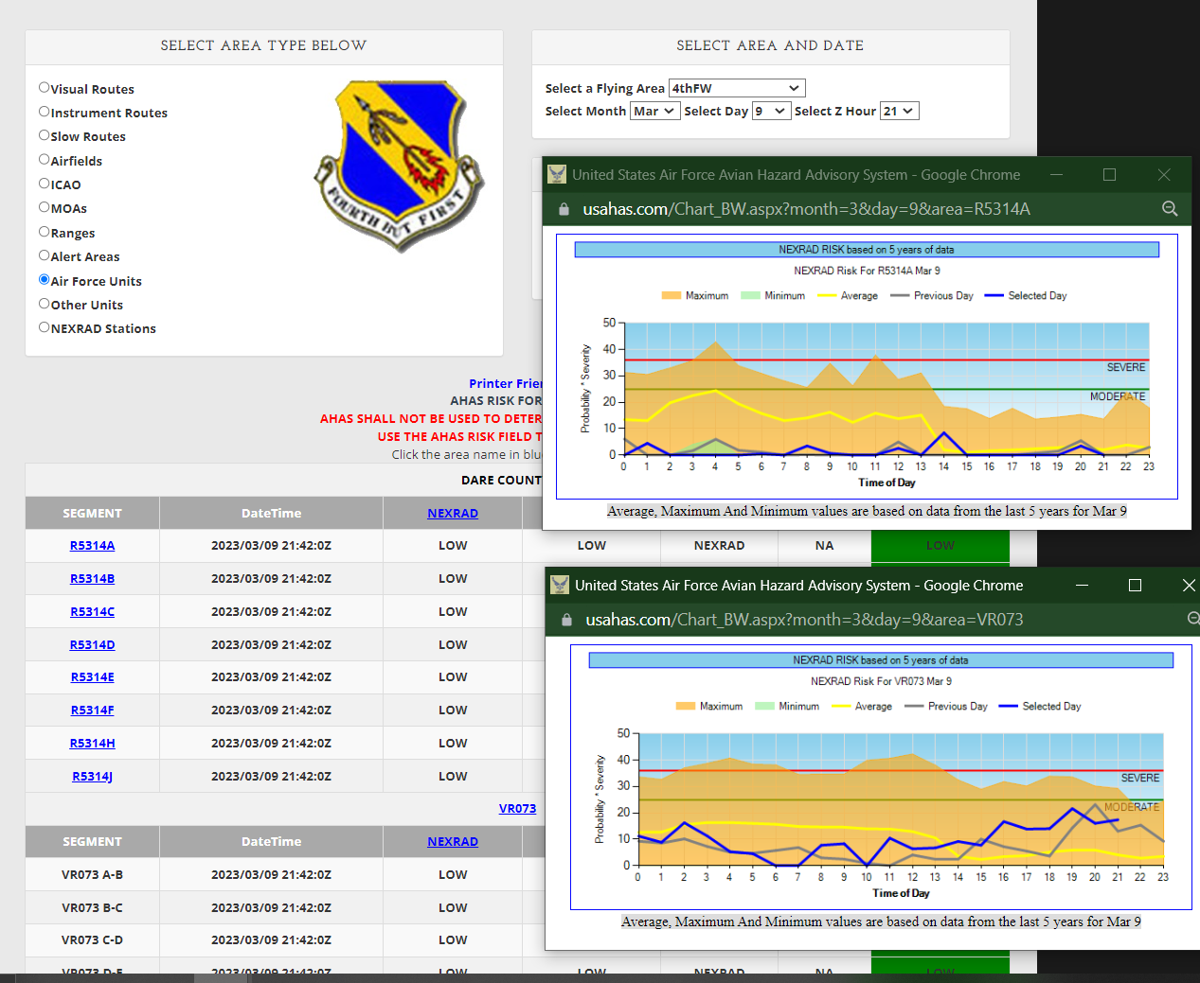
Chart - units
If selecting a unit option the chart will not display on the current web page.
For MOAs and ranges click the “segment” highlighted in blue to see a chart for that “segment”.
Click the route header to get a chart for routes and airfields.
11
Copyright 2022, DeTect, Inc, All Rights Reserved

Slide 18
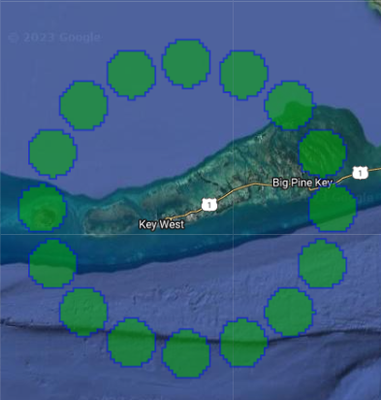
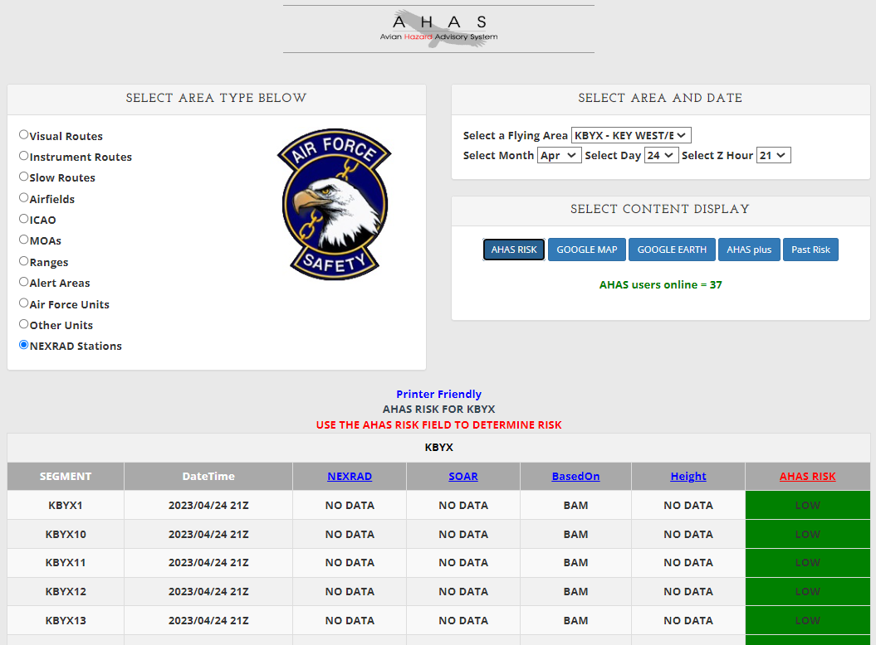
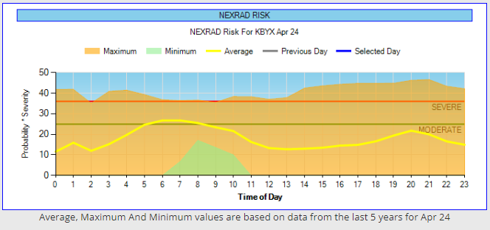
Chart – looking ahead
You can also look at the risk for a NEXRAD station.
The NEXRAD risk chart data is based on 16 sample areas around each radar.
Looking ahead can give you a good idea on what the NEXRAD risk might be like.
This example shows that the risk around NEXRAD station KBYX is moderate from about 0500z to 0800z on April 24th.
Mid to late April is the peak of bird migration from Cuba.
Looking back will no longer open a new page where you can select a specific time and get the latest risk results. The past risk button is available for that.
You can look at other time periods for any area type.
11
Copyright 2022, DeTect, Inc, All Rights Reserved

Slide 19
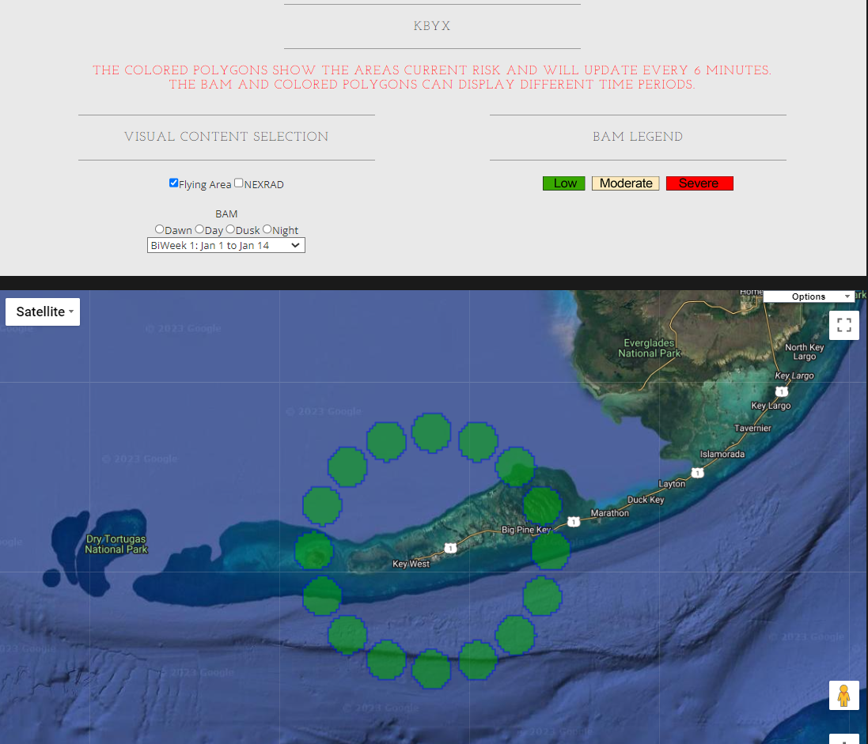
Chart – sample areas
Areas that are beyond 64 nautical miles(nm) from the nearest NEXRAD station are assessed based on the nearest area that is within 64nm of the radar.
Areas that are within 15nm of the radar are assessed based on the average value from 16 sample areas that are around each radar.
11
Copyright 2022, DeTect, Inc, All Rights Reserved

Slide 20
NEXBAM vs BAM
The BAM based on NEXRAD data (NEXBAM) is based on actual biomass in the air detected by radar.
The NEXBAM comes from up to 10 NEXRAD volume scans every hour for five years.
NEXBAM observations are seasonally accurate and consistent with recent trends.
NEXBAM updates every month with the last months data. Data older than 5 years is removed.
They now have a common scale based on the dBZ from the radar and the percentage of the polygon with biological activity. NEXBAM and AHAS live risk are equivalent.
The graphical presentation of risk over time of day, is an efficient means to see when is the best time of day to fly. Small time changes can make large scale risk reductions for the same route. Consistently bird plagued routes can be found.
The old BAM is based on bird observations made twice a year, largely of birds on the ground!
The daily chronology in the BAM was a guestimate.
The BAM, being two annual data points interpolated over time, cannot determine the changes in seasonal chronology with climate change. Winter seasons for birds are now shorter than they used to be.
The old BAM was created in the 80's and has never been updated.
The BAM risk could not easily be made consistent with the NEXRAD risk.
The old BAM could only be seen via the map page. And the time periods displayed were broad.
11
Copyright 2022, DeTect, Inc, All Rights Reserved

Slide 21
Questions?
Copyright 2022, DeTect, Inc, All Rights Reserved

Slide 22
USAF BASH Team
Mr. Dan Sullivan, Branch Chief : daniel.sullivan.26@us.af.mil, DSN 246-5674
Kyle Russell, Deputy Chief : kyle.russell.17@us.af.mil, DSN 246-5674
Capt Boss, Wildlife Ecologist : patrick.boss.1@us.af.mil, DSN 246-5848
Commercial prefix : (505) 846-xxxx
AHAS Personnel
Mr. Ron White : ahas@detect-inc.com
Florida : California : Hawaii : Calgary : London : Bejing
www.detect-inc.com www.dronewatcher.com
Copyright 2022, DeTect, Inc, All Rights Reserved

Slide 23
Thank you
United States
DeTect, Inc
2817 Hwy 77,
Panama City,
Florida 32405
USA
contact@detect-inc.com
Canada
DeTect Canada International Inc.
#7 – 503 Hurricane Drive
Calgary, Alberta,
T3Z-3S8
Canada
detectca@detect-inc.com
Europe
DeTect Global, Ltd
Afron House
Worthing Road, Horsham,
Sussex, RH 12 1TL
England
detecteu@detect-inc.com
China
DeTect China
818 West 3 Building, 18 Jian Guo New Ave, Dong Cheng District,
Beijing, 100005
China
detectcn@detect-inc.com
Florida : California : Hawaii : Calgary : London : Bejing
www.detect-inc.com www.dronewatcher.com
Copyright 2021, DeTect, Inc, All Rights Reserved

